Slide 1





How to Write a Great CV
Nick Touati
Careers Consultant
Science & Engineering Faculty Careers Team

Slide 2

Go to Menti.com
Use code
5380 9352

Slide 3
How long will an employer spend looking at your CV?
A. 15-20 seconds
B. 5-7 seconds
C. 27-30 seconds

Slide 4
How long will an employer spend looking at your CV?
A 15-20 seconds
B 5-7 seconds
C 27-30 seconds

Slide 5


Different CV types
Chronological CV
Skills-based CV
Academic
Creative

Slide 6

How to Construct a CV

Slide 7

CV basics
Clearly evidence your suitability for the role
Demonstrate how and where you developed transferable skills
Tailor your CV to the role and organisation
Concise and consistent layout, good spacing and avoid bulky text
Perfect spelling and grammar
Professional email address

Slide 8
Tailoring a CV
Research- Research the employer and role thoroughly
Demonstrate- Demonstrate how and where you developed the skills and attributes required by the employer
Show- Show relevant, individual subject units (with strong grades) at degree level
Show- Show relevant projects, dissertations, assignments or other activities at degree level
Show- Show any additional or extra-curricular achievements that might be relevant

Slide 9
Top 10 Skills- Targetjobs Survey
Commercial awareness (or business acumen)
Communication
Teamwork
Negotiation and persuasion
Problem solving
Leadership
Organisation
Perseverance and motivation
Ability to work under pressure
Confidence
10 key job skills graduate recruiters look out for | targetjobs

Slide 10
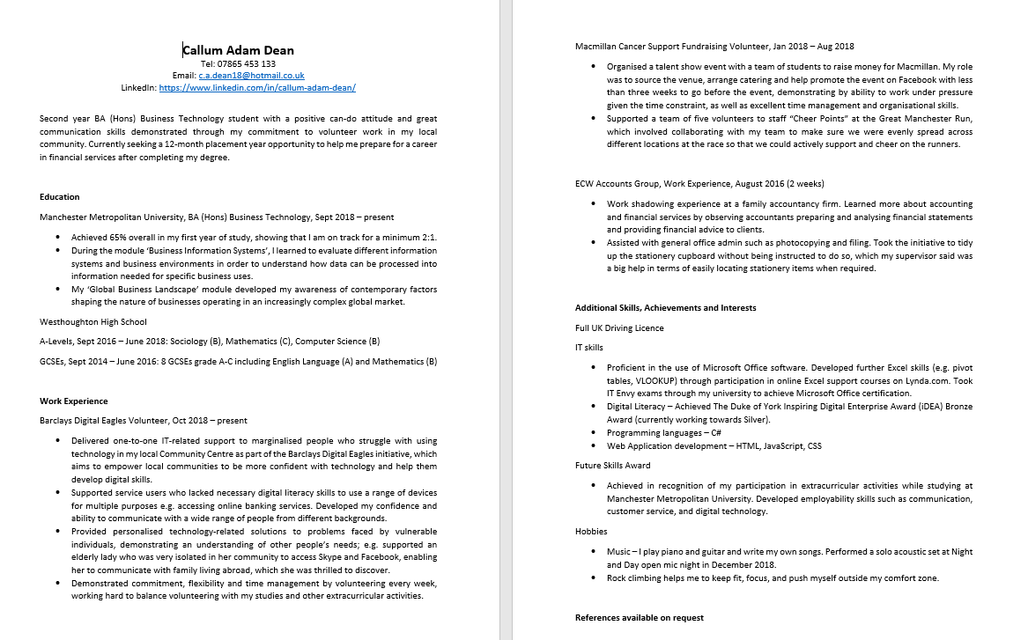

Slide 11
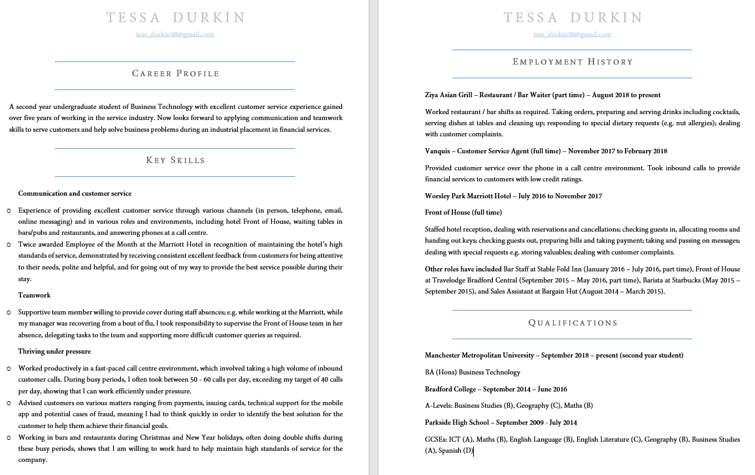
Notes:
Another sample CV to show what the finished article MIGHT look like. Discussion about the 2 types of CV, similarities, differences, preferences

Slide 12
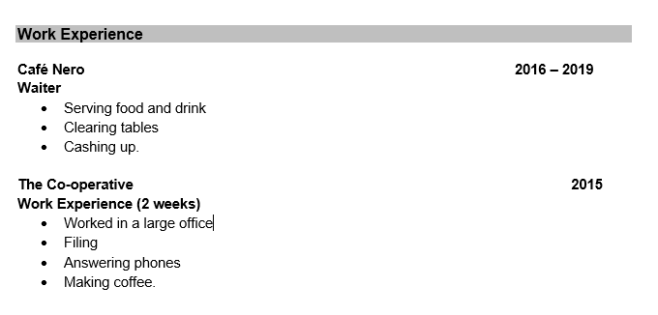
Experience
Notes:
HOW NOT TO DO IT. Discussion around this. Better version on next slide

Slide 13
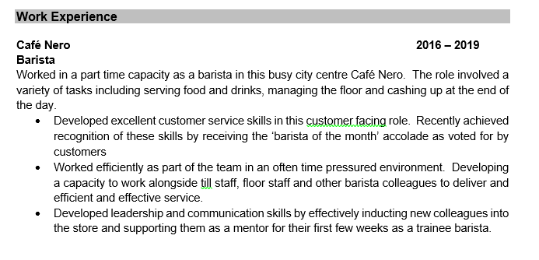
Experience
Notes:
Better version on the right. More emphasis skills, achievements. Can use STAR here… Flick to next slide and see notes for talking point.

Slide 14
What does a good profile look like?
A first year Mathematics student who has developed strong numerical skills and the ability to analyse, interpret and examine data from university study. Work experience in accountancy and job roles within the retail and hospitality sectors have developed commercial awareness and business acumen, together with strong customer service and teamworking skills. Now seeking a role in Business Intelligence and Strategy, with a focus on data visualisation and extraction.

Slide 15
What does a good profile look like?
A first year Mathematics student who has developed strong numerical skills and the ability to analyse, interpret and examine data from university study. Work experience in accountancy and job roles within the retail and hospitality sectors have developed commercial awareness and business acumen, together with strong customer service and teamworking skills. Now seeking a role in Business Intelligence and Strategy, with a focus on data visualisation and extraction.

Slide 16
Education
Most recent first i.e. reverse chronological
Develop the degree section: relevant, subject units, project work, assignments etc.
Individual A levels, best grades first
BTEC: Write out Distinction, Merit etc.
GCSEs- one line
Other Achievements e.g. Staff-Student Committee, Prefect

Slide 17
Work experience/placements
Introductory lines??
Bullet-points: concise and specific
What did you observe and learn in terms of both work and practice and skills
What did you do- main duties & achievements
Technical skills developed
Transferable skills developed

Slide 18
Employment/work history
Introductory lines??
Bullet-points: concise and specific
What did you do- main duties, responsibilities & achievements
Promoted or selected?
Illustrate how and where you developed key transferable skills and attributes

Slide 19
Additional information
Additional skills: “Hard”/technical e.g. IT, Languages
Achievements: Extra-curricular
Achievements: Academic- prizes or awards
Positions of responsibility
Interests

Slide 20
Additional skills
IT skills: Proficient in the use of Microsoft packages, including Excel and Access to create spreadsheets and analyse complex data sets.
Languages: Fluent spoken and written French and a good conversational knowledge of Spanish.
Driving: Full UK driving licence

Slide 21
Interests & achievements
Interests- be specific and interesting, be different, unusual or quirky
“ I enjoy hiking and have recently completed the 19 km Tongariro crossing.”
“I enjoy reading contemporary science fiction, particularly the work of Iain M. Banks and Michael Cobley.”

Slide 22

How to write a great covering letter
A tightly written covering letter can be a very persuasive selling tool. It highlights the candidate’s interest in the organisation and the position, and will highlight some leading achievements from the CV.
It will lead the employer to the CV and hopefully the employer will read the CV for longer at the initial stage and thus a candidate is more likely to be shortlisted for the next stage.
It is the appetiser, with the CV being the main course!

Slide 23
Covering letter- technique
One side- tight and concise
Opening paragraph
Points to cover
Avoid rambling and meandering- keep to the point and keep points together
Avoid writing a “life story”
Final closing paragraph
Bring in experience and achievements to back up, illustrate and support your points

Slide 24
Covering letter- points to cover
Why that position?
Career goals & ambitions: work areas and specialisms of interest
Why that company/organisation?
Why you are a good candidate
Sell yourself: skills & qualities, backed up by evidence
Bring in experience and achievements to back up, illustrate and support your points

Slide 25
Letter writing technique
Your address, top right, but not your name, name goes bottom
Space to date underneath
Employer’s address top left, one space under date
Dear Mr/Mrs/Ms etc
Bold title line
Yours sincerely- named person
Yours faithfully- no named person

Slide 26
Useful resources
CV 360- gives feedback on your CV, and areas to develop
CV Builder- helps you to put a CV together
CV and Covering Letters guide- Careers Service guide to CVs and covering letters
Graduate Prospects guide to CVs and Covering Letters

Slide 27

Thank you for listening!
Any questions!!!

